Slide 1
Curveball
CVE-2020-0601

Slide 2
What is it?
Issue was reported by the NSA
It is an ECC signature spoofing vulnerability found in the Windows CryptoAPI (crypt32.dll).
Attacker could exploit the vulnerability by using a spoofed code-signing certificate to sign a malicious executable.
Example: Malicious executable seemingly signed by Windows would be trusted by even a veteran Information Security specialist.
Affects Windows 10, Windows Server 2016, Windows Server 2019
Notes:
https://media.defense.gov/2020/Jan/14/2002234275/-1/-1/0/CSA-WINDOWS-10-CRYPT-LIB-20190114.PDF
Image:
https://images.hothardware.com/contentimages/newsitem/50466/content/Windows_Curveball.jpg

Slide 3
Implications:
Curveball affects:
HTTPS Connections
Signed Files and Emails
Signed executable code launched as user-mode processes
Possible Attacks:
Man in the middle attacks using malicious certificate.
Use fake certificate to mimic websites.
Notes:
https://media.defense.gov/2020/Jan/14/2002234275/-1/-1/0/CSA-WINDOWS-10-CRYPT-LIB-20190114.PDF

Slide 4
What Should You Do:
UPDATE YOUR WINDOWS INSTALLATION..
Seriously…. That's it
You also may want to update your browsers as well.
Chrome has released an update to fix the TLS issue.

Slide 5
Social Engineering
By Ali Ahmed and Hassaan Mustafa

Slide 6
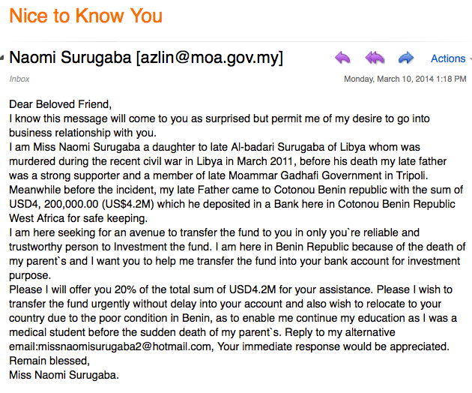
Social Engineering Attack: An Example
Notes:
https://blogs.akamai.com/The-Nigerian-Scam-2.png
https://steemitimages.com/DQmUeVWYSR1wYvZEievycR2hsGkJYMBePKrWDcKCHFhq6Eu/re7_6nnJS8KFZsQW54Tnqw.png

Slide 7
What is Social Engineering?

Slide 8
The Motivation
You are only as secure as your weakest link
In information security, people are consistently the weakest link
SEAs are normally the initial attack vector
Only about 3% of malware tries to exploit an exclusively technical flaw
97% of malware targets users through social engineering
17% of people within a company are susceptible to phishing attacks
Number jumps up to 33% through official channels
How long does it take for organizations to detect a data breach that is due to email phishing?

Slide 9
Some Statistics

Slide 10
Some More Statistics
94% of malware was delivered by email. (Verizon)
48% of malicious email attachments are office files. (Symantec)
13 web requests lead to malware. (Symantec)
22% of all folders were available to every employee. (Varonis)
Most malicious domains, about 60%, are associated with spam campaigns. (Cisco)
Notes:
https://owlpower.eu/wp-content/uploads/2018/07/01.png
https://www.slideshare.net/IntegritySRC/what-is-social-engineering-an-illustrated-presentation-70347323
https://image.slidesharecdn.com/integrity-socialengineering-slideshare-161221172851/95/what-is-social-engineering-an-illustrated-presentation-6-638.jpg?cb=1482341389

Slide 11
5 Common Attack Methods
Dumpster Diving
Pretexting
Phishing
Physical Entry
Enticement
Notes:
https://www.slideshare.net/IntegritySRC/what-is-social-engineering-an-illustrated-presentation-70347323
https://hackernoon.com/drafts/hn2x73xo5.png

Slide 12
Track down improperly discarded sensitive information.
Physical Items: company notebooks, printed emails, etc.
Check password dumps, hacked website dumps online.

Slide 13
Pretexting:
Fraudulent phone calls
Used to extract information
Also used to setup other attacks such as facility entry or phishing.
Notes:
https://www.thesecurityawarenesscompany.com/2018/07/12/pretexting-psychology-scam/

Slide 14
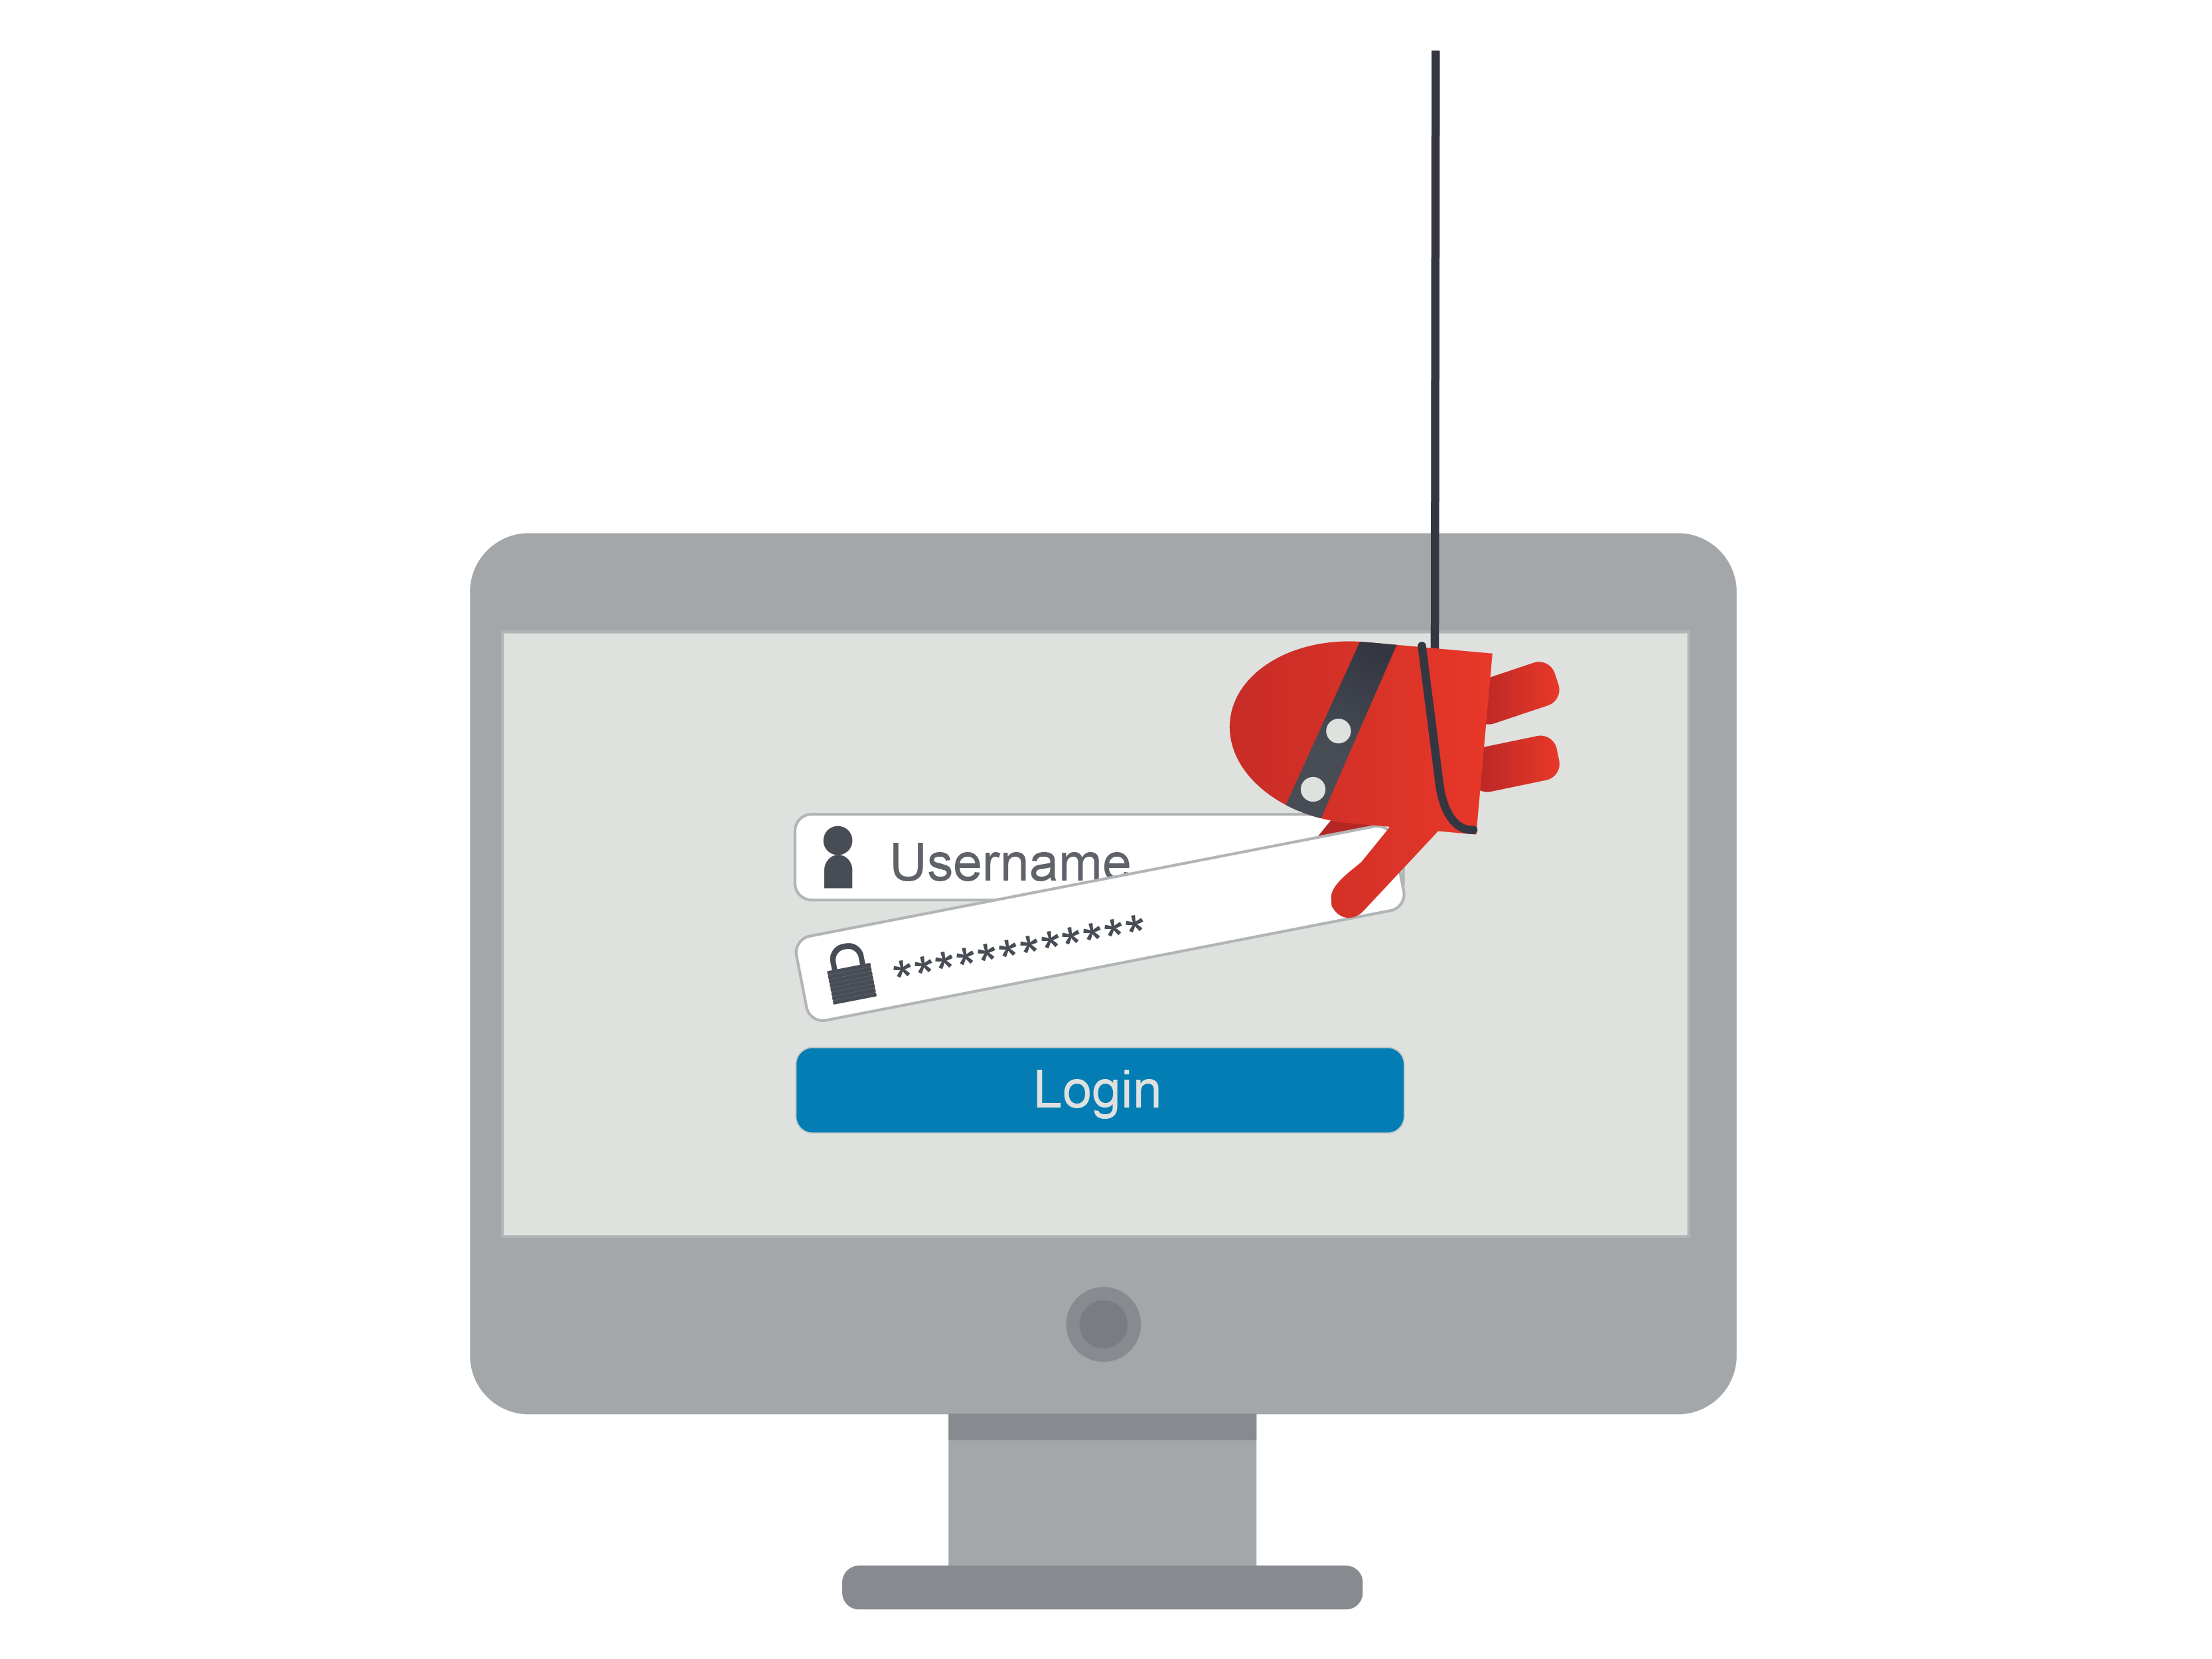
Phishing
Crafting malicious electronic communication that appear to be from a trusted source
Usually asks recipient for confidential information or to click on malicious links (or attachment)
Generally in the form of emails
Notes:
https://www.sans.org/sites/default/files/Ouch-phishing_Red-01.png

Slide 15
Common discrepancies in Phishing emails
Email asks you to update credentials or open links in a different way
The layout of the email is unfamiliar or has weird discrepancies.
Spelling mistakes
Hyperlinks lead to unknown domains
Notes:
https://umanitoba.ca/computing/ist/security/media/phishing_email_oct_20_2017.png

Slide 16
Facility Access
Hackers may use physical entry to complement their attacks:
Impersonate staff to enter facility by using information on social networks
Bypass security by dropping USBs
May involve months of planning before execution
Preparation:
Finding a company phone list or org chart
Getting to know employees
Notes:
https://www.gograph.com/clipart/spy-sneaking-gg75508399.html
https://www.slideshare.net/IntegritySRC/what-is-social-engineering-an-illustrated-presentation-70347323

Slide 17
How do you stop Social Engineering?

Slide 18
Prevention:
Education: Keep employees updated on recent attacks.
Have emergency procedures in place.
Incident management and phishing reporting
Proper disposal of sensitive information
Red Teaming
Repeated trainings
Notes:
https://gvcps.ca/wp-content/uploads/2019/12/Need-Foreclosure-Prevention-Assistance-1024x551_edited.jpg

Slide 19
On-going Attack:
Isolate infected terminal
Change access codes
Sweep the facility
Report to the police

Slide 20
Aftermath:
Review security footage
Restore from most recent backup
Check for ransomware
Change compromised confidential information (logins, codes, accounts)
Review and update security protocols to prevent attack in the future
Notes:
https://www.airlines.iata.org/sites/default/files/event_images/Web_cyber_security_shutterstock_1041066733.jpg

Slide 21
Standard Anti-Social Engineering Training:
Train
Train employees to recognize the various scenarios of Social Engineering.
Examples: Dumpster Diving, New Hire, Pointed Question, Tailgating, Impersonation
Examples
Familiarize employees with real life examples and references
Corporate Policy
Construct and familiarize employees with corporate policy regarding specific workplace.
Mindfulness
Let employees know that safeguarding company data is part of their job, even when they are not clocked in
Test Staff
Test the staff by hiring someone to red team the workplace.
Notes:
https://www.pinkelephant.com/uploadedimages/LandingPages/USCAN/Training/ITSM-training.png

Slide 22
Testing the staff:
What happens during red teaming?
Red team can do things like:
take badges and credentials left in unlocked cars
pose as janitorial staff
attempt to access secured room without a badge
Pose as IT professionals
Clone an employee’s access card
Teach employees how to ask the right questions.
“Can I see your ID please? Hold on for a second while I verify your clearance.”
“No, I’m sorry but you can’t use my ID. Where’s yours anyways?”
“I’m going to have to talk to my manager about giving you that information.”
A red team task force is assembled to conduct secret “social engineering” operations to see how employees respond

Slide 23
Introduction to SET
Completely free and open source
Released under GNU GPL license
Software package designed specifically to execute SEAs
Able to design technically sophisticated SEAs
Provides a simple, menu driven interface
Written in Python

Slide 24
Software Dependencies
Metasploit framework
For payload generation and event sink (not to be confused with event sync) setup
Java Development Kit
For Java-based payload generation
Ettercap
For DNS spoofing attacks
Sendmail
For spoofing sender's email address
Plus many more!!!
Notes:
https://ieeexplore-ieee-org.myaccess.library.utoronto.ca/stamp/stamp.jsp?tp=&arnumber=5967295

Slide 25
SET Attack Vectors
Provides different attack vectors which are used to send victims a chosen/configured payload
Once payload is sent to the victim, a connection to the attacker's computer is being established
Provides an opportunity for the attacker to perform various actions on the victim's computer
Email-based attack vectors
SET provides means to generate Email messages
Generate and attach a payload to them
Start an event sink on the attacker's computer
Malicious Media Generator
Delivering payload to target via physical media
Media is usually labelled something innocuous.
Creating payload and listener
Can create a payload that can be delivered manually.
Simple wrapper around the Metasploit framework
Teensy USB HID Attack Vector:
A special device designed to be disguised as a Human Input Device.
Emulates a real keyboard
Notes:
https://ieeexplore-ieee-org.myaccess.library.utoronto.ca/stamp/stamp.jsp?tp=&arnumber=5967295

Slide 26
SET Attack Example: Hijacking Webcam
We can use a mass email attack to phish for victims.
The email will be designed to mimic a professional email. It has a payload attached.
Using a reverse TCP Meterpreter payload, we can gain control of the system and give us a backdoor to the system
Using said backdoor, we can enable the webcam and spy on the victim.
See tutorial notes for instructions.
Notes:
https://docs.google.com/document/d/10TrV0pJ6LYJ-WakvSgPr6CgAV2lPiOtZiQ07A5U57DA/edit?pli=1

Slide 27
Web based attack vectors:
Java applet attack: Setup fake web-interface on a local web server. Can be used to deliver malicious payload
Metasploit browser exploit: Use different exploits for browser vulnerabilities to gain control of computer.
Credential harvester method: Can create a fake website login page. Captures POST variables.
TabNabbing method: Take advantage of victim having several tabs open + CDM/JAA
Man left in the middle: XSS Scripting Attack
Web jacking method: Credential Harvester + Extra Social Engineering.
Multi-attack: Any combination of the above.
Notes:
https://ieeexplore-ieee-org.myaccess.library.utoronto.ca/stamp/stamp.jsp?tp=&arnumber=5967295

Slide 28
Questions?

